Slide 1
Résumé Mise en place
A Résumé Workshop for Culinary Arts Students

Slide 2
What is a Résumé?
A marketing tool – you are marketing yourself
A brief overview of education and relevant activities to demonstrate skills and accomplishments
A document tailored to each position / organization
The first (and maybe the only) impression
Let’s look at some

Slide 3
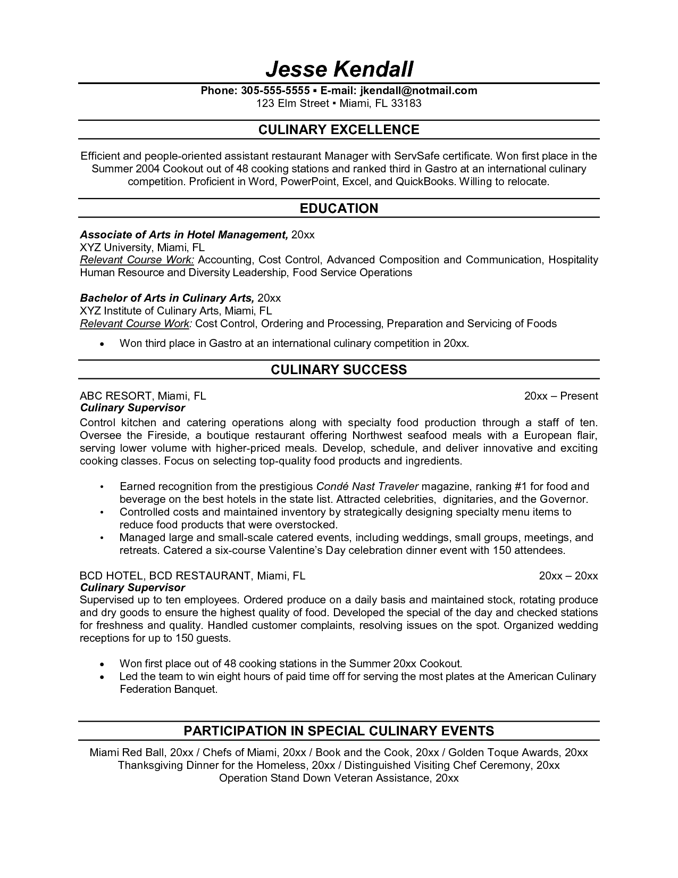

Slide 4
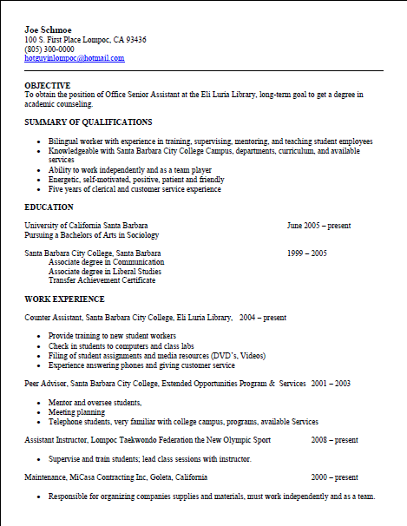

Slide 5
Résumé Writing Guidelines
YOU MUST TELL THE TRUTH!!
Résumés are subjective– few true rules
What you include & HOW you include it, has an impact
Prioritize the information in order of interest to your reader– top left is highest emphasis

Slide 6
Linking Yourself to the Position
This is the key to success
Match YOUR skills & qualifications to THEIR requirements and keywords
Critique your résumé as if YOU were the employer– what would YOU want to see?
This is the single most important aspect of résumé writing!

Slide 7
For Example…
Conduct training for personnel
Cook in quantity
Direct and coordinate food or beverage preparation
Monitor worker performance
Cook meals
Investigate customer complaints
Maintain production or work records
Price items on menu
Determine food or beverage costs
Modify work procedures or processes to meet deadlines
Schedule employee work hours
Direct and coordinate activities of workers or staff
Estimate materials or labor requirements
Use oral or written communication techniques
Inspect facilities or equipment for regulatory compliance

Slide 8
Résumé Journal
You do amazing things every day in the culinary program
Though often we forget experiences quickly
A resume journal is an informal list of experiences and accomplishments
This will make customizing your resume for specific positions much easier!

Slide 9
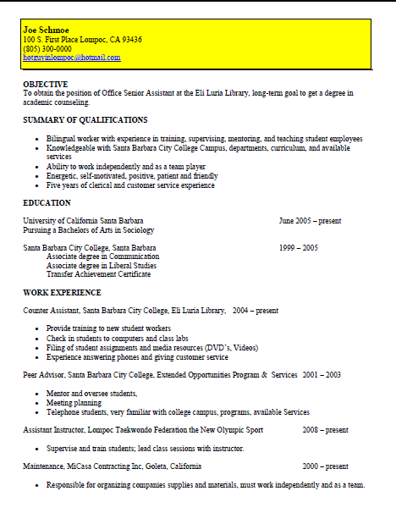
Parts of a Résumé : Contact Info
Emphasize your Name
Use a local address if reliable
Phone numbers: use cell phone number if you have a professional voice mail greeting
Provide appropriate e-mail address (NOT lazyboybob@...) and check on a daily basis
Recommend 10-12 font size for contact information and remainder of résumé

Slide 10
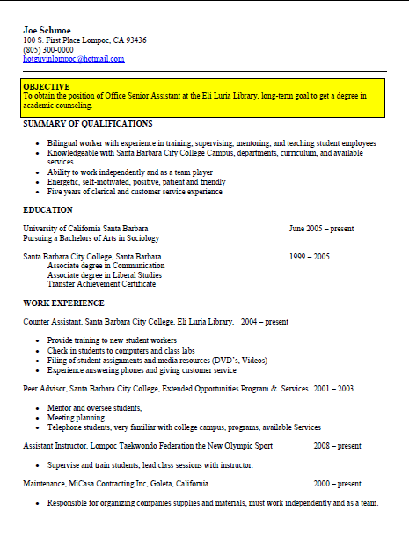
Parts of a Résumé:
Objective Statement
I want a job with a company who will value me and allow me to grow and gain experience.
vs.
Seeking a Sous Chef position with Bacara Resort & Spa, utilizing my food styling skills for banquet, buffet and a la carte presentation.
or
Seeking Sous Chef position at Bacara Resort & Spa

Slide 11
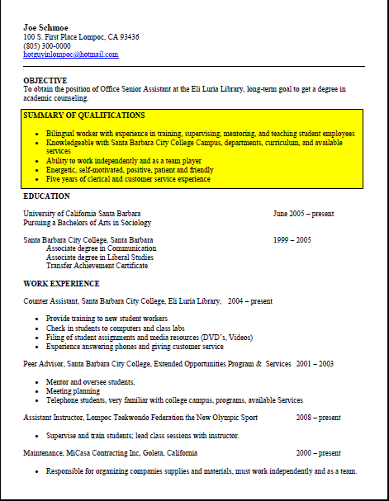
Parts of a Résumé: Summary of Qualifications
Summarize your key strengths for the position
Can be called other things: Professional Profile, Culinary Excellence, Culinary Highlights
Not too many items (Roughly 3-5)
Be specific – paint a picture
This area should be ESPECIALLY tailored to position
Speak THEIR language

Slide 12
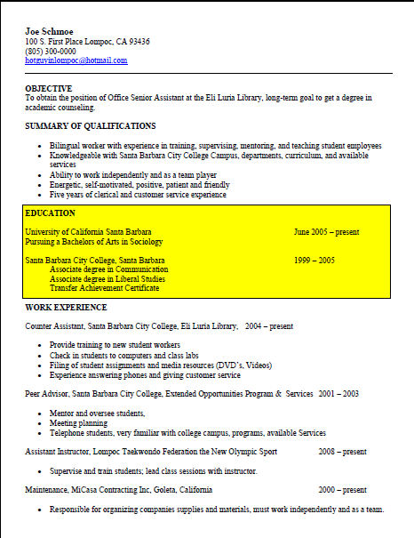
Parts of a Résumé: Education
Don’t underestimate the importance of your education on your résumé
Think in terms of skills and experience...just like describing professional experience
List coursework and projects when applicable
SBCC can be your calling card

Slide 13
Education Example
Santa Barbara City College, Santa Barbara, CA
A.S., Culinary Arts, Santa Barbara City College, Santa Barbara, CA, Expected graduation date: May 20XX
Honors: 3.6 GPA, Dean’s List (2 terms)
Related Coursework: Hospitality Sanitation & Safety, Principles of Baking, Purchasing & Receiving
Special Projects: Vegetable and fruit carving demonstration, Pulled sugar competition.

Slide 14
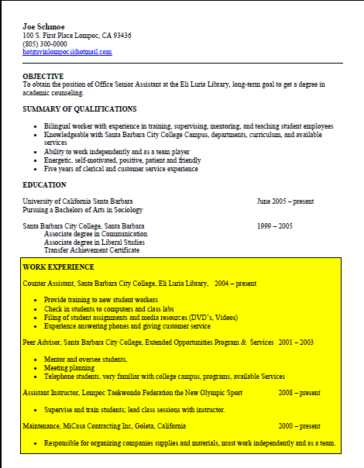
Parts of a Résumé: Experience
BE CONSISTENT
Include: Title, Organization, City, State, Dates
Include accomplishments rather than duties in bullet form
If your job title is not descriptive, consider replacing it with a functional title (Student Worker III = Asst Mgr of Graphics Lab)
Note: Your degree is your “job title” under Education (i.e. AA, Graphic Design)

Slide 15
Describing Work Experience
Focus on accomplishments, not routine duties
Use ACTION verbs – created, managed, coordinated...
Use numbers (numerals) whenever you can: $9800, 7 clients, 45%
Use a superlative whenever you can: first, best, fastest, largest
Write long on your first draft - you can edit later

Slide 16
Take a Management Point of View
Provide budget data even if that did not personally interest you
Show some understanding of how your task fit into the company’s overall goals
“Resulted in 5% reduction in inventory due to more efficient logistics, representing a one-time $5,000,000 savings to company
Are you contributing to the “bottom line” or goals of the business?

Slide 17
Experience Example #1
1997-1999 Swersky Construction, Santa Barbara, CA
Bob Swersky, Supervisor
1235 Overlook Drive
805-620-7314
Laborer– hammered nails, thumbs; mastered expletives

Slide 18
Experience Example #2
Construction Crew Assistant, Swersky Construction,
Santa Barbara, CA Summers 2007-2009
Coordinated with crew of 4 to build homes
Rapidly adapted to changing work orders
Maintained tools worth over $1000
Beginning training in reading blueprints and structural requirements

Slide 19
Parts of a Résumé: Other Sections
Campus/Community Involvement
This is one example...think of some of your own
References
They are assumed; use the space to expand on your qualifications
Create a reference list (with professional and/or scholastic contacts) to give them when they do ask, but not before.

Slide 20
Résumé Formatting
Chronological? Functional? Combination?
Length: ONE PAGE?
Font and margin considerations
Use bold type, italics, or underlines to highlight important information
Your résumé should be NEAT, PROFESSIONAL and EASY TO READ
Absolutely NO typographical errors!

Slide 21
Chronological Format
Advantages
It’s the most common & traditional style.
Employers find it easy to understand.
It’s generally easier to write.
It emphasizes career laddering.
Disadvantages
Most recent experience may not be your most important or relevant experience.
May have little or no work experience or feel their work experience is unimpressive.
Don’t want to be stereotyped on the basis of past work experience.

Slide 22
Functional Format
Advantages
Useful when you want to emphasize abilities not used in recent work experience.
May be useful when entering the job market for the first time or changing careers.
Disadvantages
May be difficult to write.
May be confusing to employer or create skepticism due to lack of content.

Slide 23
Do Don’t
Emphasize your name
Be consistent
Use numbers
Match keywords to the job posting
Describe projects
TELL THE TRUTH!
Use the word “I”
Use fluff phrases– e.g., Responsible for, Duties include, etc.
Use graphics or colors or photos
Allow ANY spelling or grammar errors

Slide 24
Check out our new
How to Get Hired Video series!

Slide 25
Have fun! Come to the Career Center if you need help or want your résumé reviewed.

